Slide 1
CS686: RL and Robotics 1. End-to-End Robotic Reinforcement Learning without Reward Engineering 2. Leveraging Demonstrations for Deep Reinforcement Learning on Robotics Problems with Sparse Rewards
Junyong Park 20184310

Slide 2
Contents
Review of previous presentation (by Min Kim)
Paper 1:
End-to-End Robotic Reinforcement Learning without Reward Engineering
RSS 2019
Paper 2:
Leveraging Demonstrations for Deep Reinforcement Learning on Robotics Problems with Sparse Rewards
arXiv (by Deepmind, 99 citations)

Slide 3
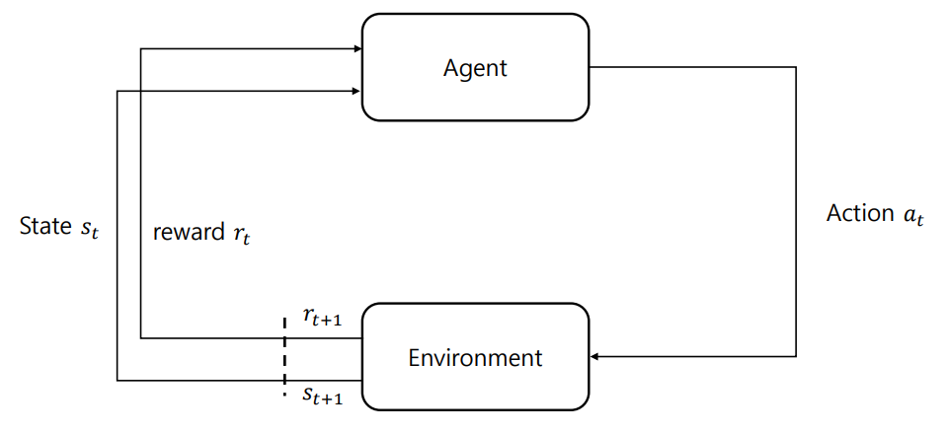
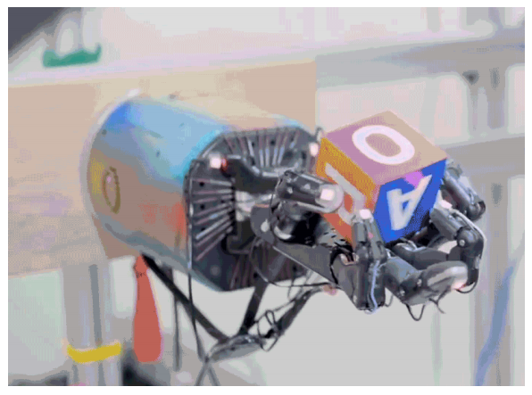
Review of previous presentation
Basic introduction to RL
State-Value Function, Q-function
Bellman Operators, Policy Gradients
“Deep Reinforcement Learning for Robotic Manipulation with Asynchronous Off-Policy Updates”
Use Asynchronous NAF (Normalized Advantage Function)
Train multiple robots in parallel
“Learning Dexterous In-Hand Manipulation”
Transferable Simulations

Slide 4
End-to-End Robotic Reinforcement Learning without Reward Engineering

Slide 5
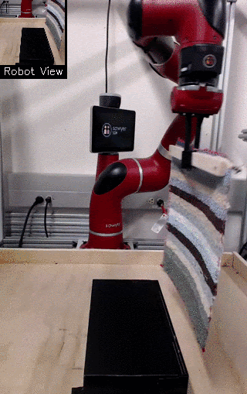
Contribution
Learning robotic skills from high-dimensional observations (e.g. images) without hand-designing reward functions and minimal human intervention.

Slide 6
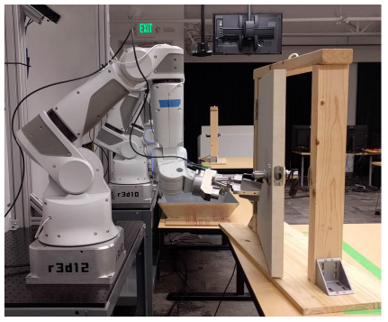
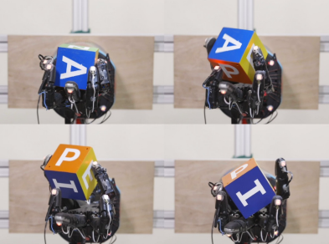
RL and Robotics
Grasping objects, in-hand object manipulation, manipulating fluids, door opening, and cloth folding etc.

Slide 7
End-to-End Robotic Reinforcement Learning without Reward Engineering
Skill learning directly from raw sensory observations such as images
Every aspect of the robot’s estimation and control pipeline can improve from experience and become better suited f0r the task

Slide 8
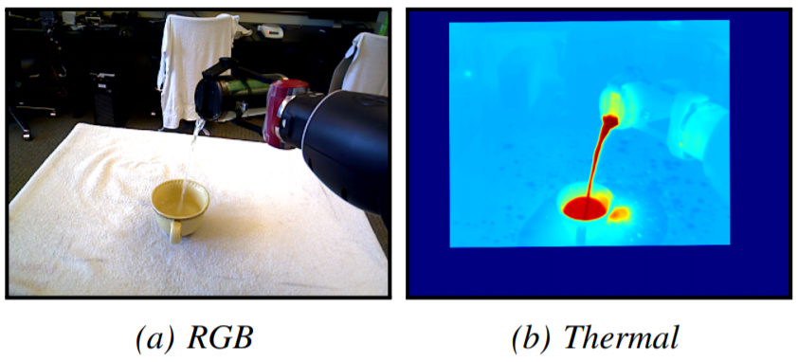
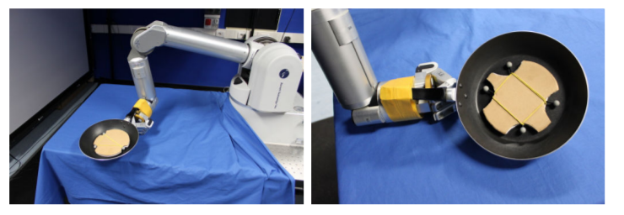
End-to-End Robotic Reinforcement Learning without Reward Engineering
Reward function r_{t} := r_{t}(s_{t}, a_{t}) -> A value that we want to maximize.
Designing reward functions for robotic skills is challenging
Especially when learning skills from raw observations (e.g. images)
Manually defining reward functions requires special perception systems or sensors
ICRA 2017 IROS 2010

Slide 9
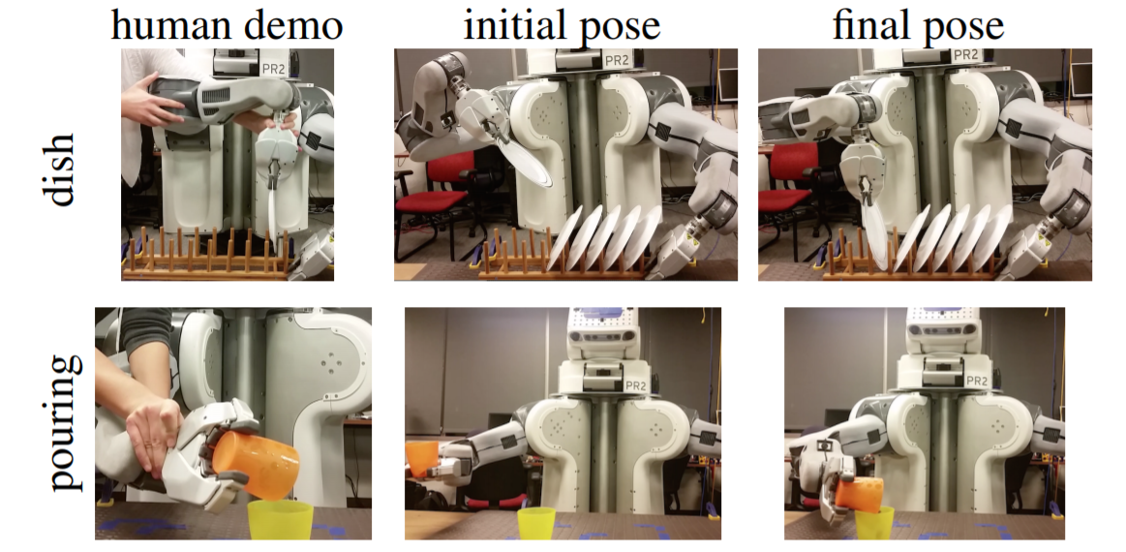
Inverse Reinforcement Learning
Automate reward definition by learning a reward function from expert demonstrations
BUT
Collecting expert demonstrations is a burden on the user
Demonstrations are non-intuitive for a person to provide (kinesthetically moving a robot)
Notes:
demonstrating how a task is done defeats a central goal of reinforcement learning: autonomously discovering how to perform skills through trial and error.

Slide 10
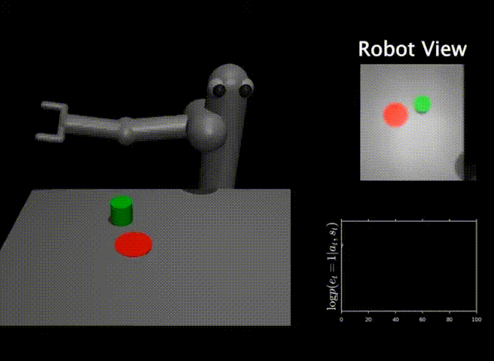
Classifier Training
Train a goal classifier on data of images of the goal
Use the success probabilities from this classifier as the reward
BUT
Can be exploited by RL if not trained well
Visit parts of the observation space that the classifier was not trained on

Slide 11
Goal
Make it possible to specify reward functions for robotic reinforcement learning with:
A small number of outcome examples
- e.g., photographs of a successful task outcome
followed by a few active queries
- the robot asks the user if a particular outcome is a success or not.
Notes:
In RL, the goal is to learn a policy in a Markov decision process, which in a robotic control problem consists of a state space S and an action space A. In our case, the state space consists of image observations, and the action space consists of desired end-effector motion

Slide 12
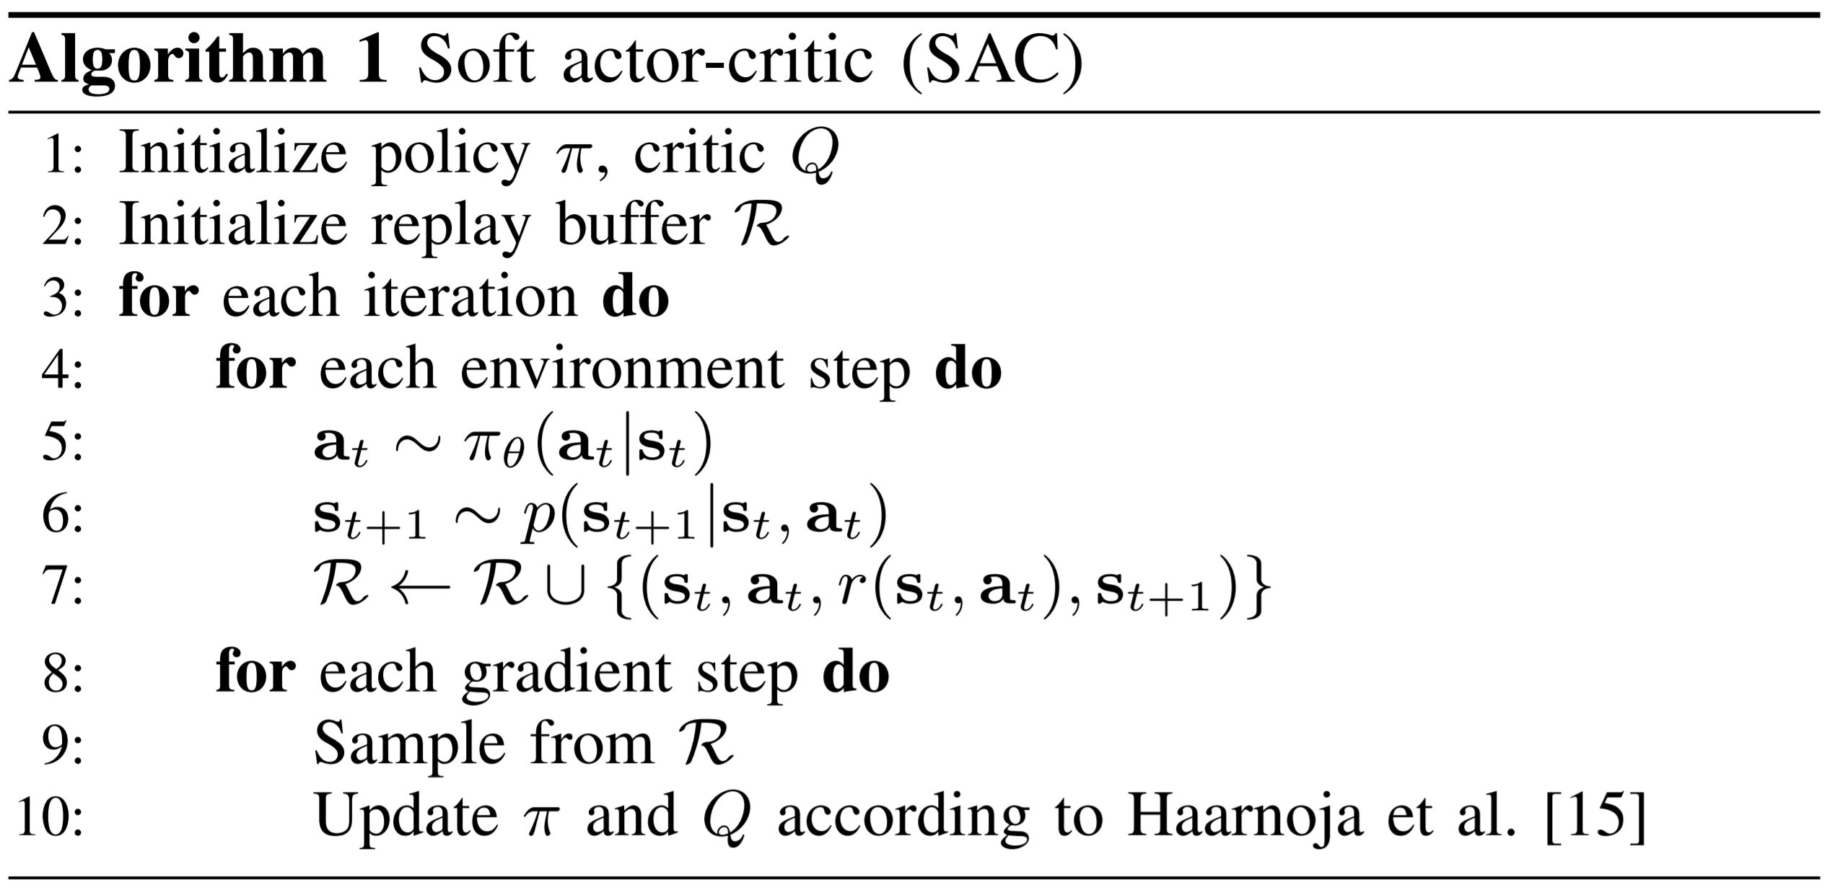
Soft Actor-Critic (Maximum Entropy RL)
Maximize the entropy of the trajectory distribution
2 benefits:
produce stable/robust policies for real-world RL
straightforward to integrate with VICE
Soft actor-critic
stores past transitions in a replay buffer R
trains both a critic and a maximum entropy actor on batches sampled from this buffer
at the same time collects experience with the current stochastic policy
Notes:
We can think of entropy as how unpredictable a random variable is
the optimal policy not only maximizes the expected return (first summand) but also the expected entropy of itself (second summand).
We want a high entropy in our policy to explicitly encourage exploration, to encourage the policy to assign equal probabilities to actions that have same or nearly equal Q-values, and also to ensure that it does not collapse into repeatedly selecting a particular action that could exploit some inconsistency in the approximated Q function.
Therefore, SAC overcomes the brittleness problem by encouraging the policy network to explore and not assign a very high probability to any one part of the range of actions.
SAC makes use of three networks: a state value function V parameterized by ψ, a soft Q-function Q parameterized by θ, and a policy function π parameterized by ϕ.
SAC concurrently learns a policy π, two Q-functions Q1 Q2, and a value function V.

Slide 13
Classifier-Based Rewards
D := {(s_{n}, y_{n})}, dataset of example states (e.g. images)
g(s), binary classifier to predict whether a given state is a success or failure
y_{n} = the binary success or failure label
L = a binary classification loss (e.g. cross-entropy loss)
Classifier provides a distribution p_{g}(y|s) -> reward is given by log p_{g}(y|s)
Requires positive and negative examples. Policy can learn to exploit the classifier

Slide 14
Active Queries (RAQ)
Instead of a prespecified static dataset
Query a user for success labels for different states
This addresses two major challenges with classifier-based rewards:
No need for a complete set of negative examples
Helps prevent the classifier exploitation problem.
Notes:
Typical RL require 10,~100,000 states worth of data

Slide 15
Active Queries (RAQ)
Which states to ask?
Unlabeled states with the highest probability of success
Reward binary classifier specifies a distribution p_{g}(y|s)
The reward is given by log p_{g}(y|s).
Positive states are more helpful for learning
Only states with positive predictions can be false positives, ∴ can avoid classifier exploitation
How often?
Queried at fixed intervals
Based on the expected training length
Notes:
y is a binary variable

Slide 16
VICE (variational inverse control with events)
Classifier-based reward specification framework
Properties
Uses on-policy RL with policy gradients
Requires a large number of positive outcome examples
Can overcome the classifier exploitation problem by using all of the data collected during RL
http://papers.nips.cc/paper/8073-variational-inverse-control-with-events-a-general-framework-for-data-driven-reward-definition.pdf

Slide 17
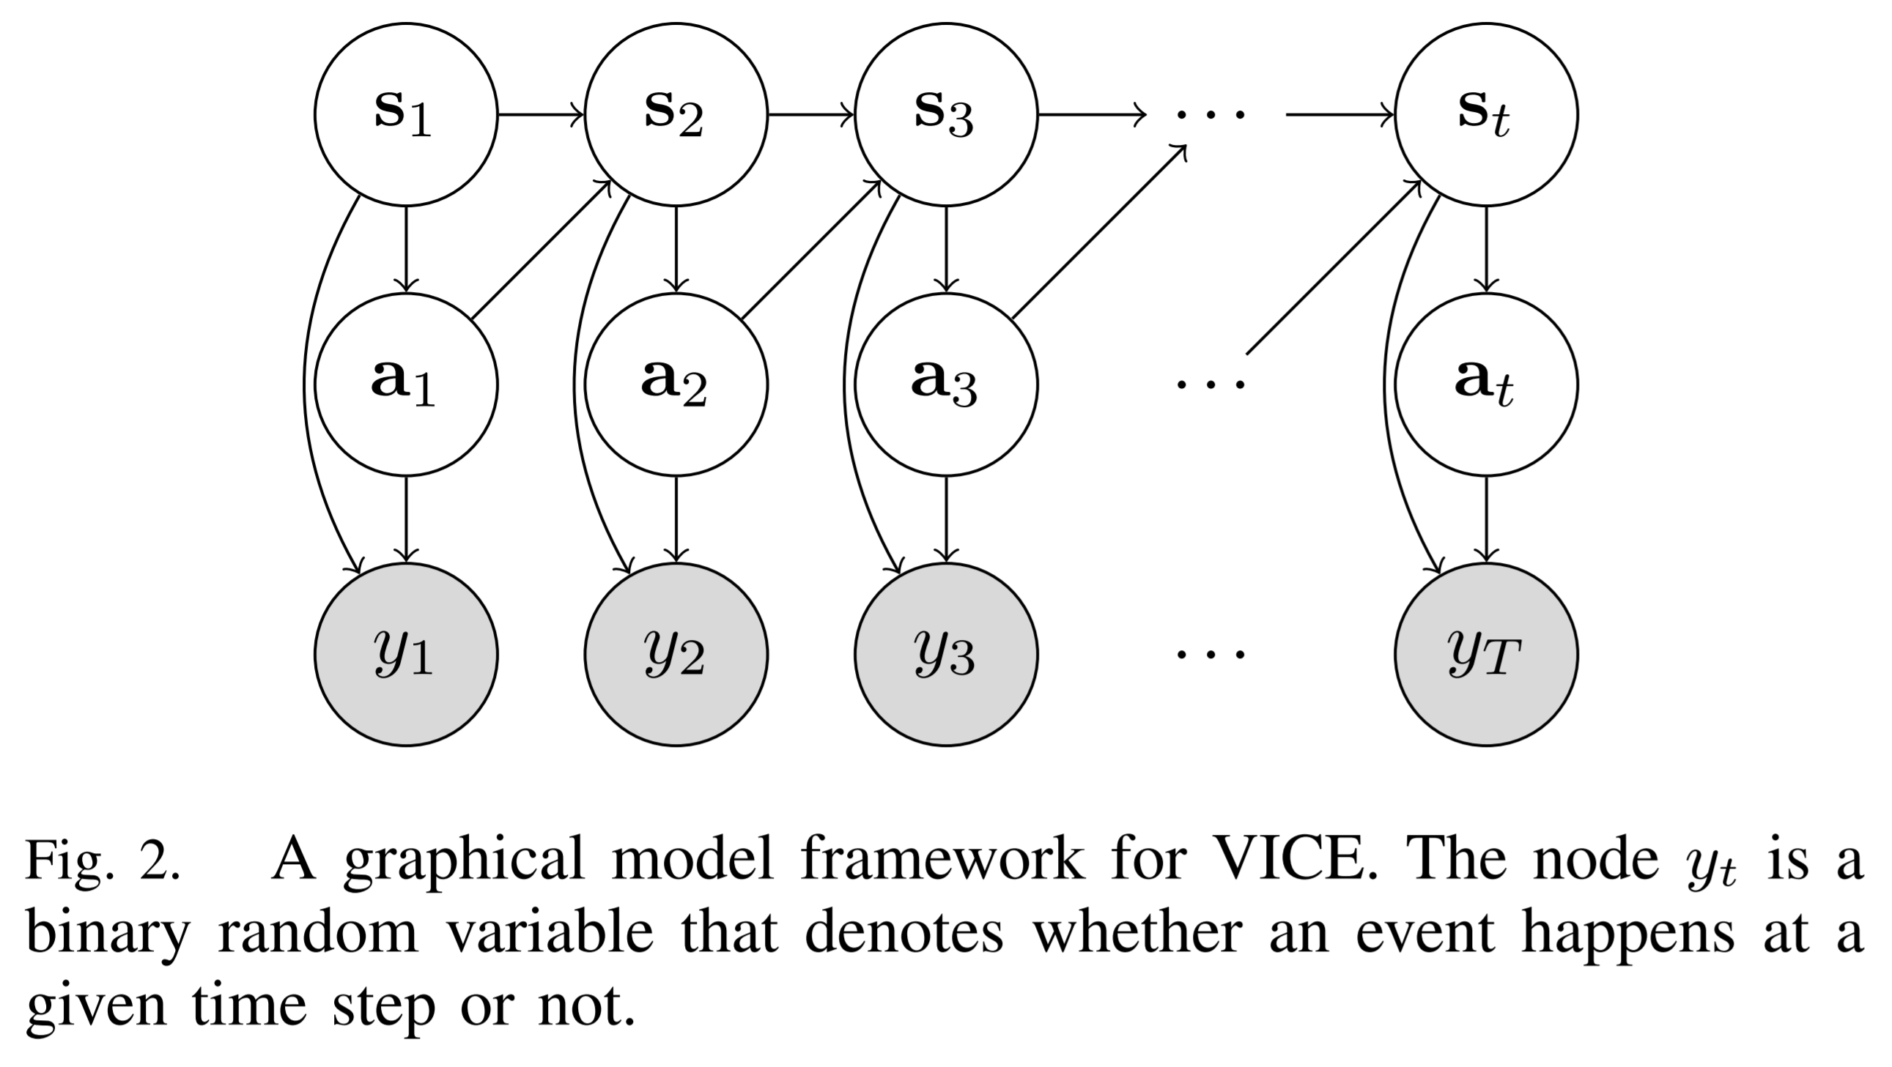
VICE (variational inverse control with events)
A binary event variable y_{t}
Whether a particular event has taken place at time t
agent’s goal: maximize the probability that a certain event will happen at some point in the future, rather than maximizing cumulative rewards
Notes:
In addition to the states and actions, this graphical model also includes binary event variables, yt. Intuitively, these variables denote whether a particular event has taken place at time t, which in our case corresponds to successful completion of the task.
(Adversarial mining negatives from the learned policy
generalizes inverse reinforcement learning methods to cases where full demonstrations are not needed, such as when only samples of desired goal states are available)

Slide 18
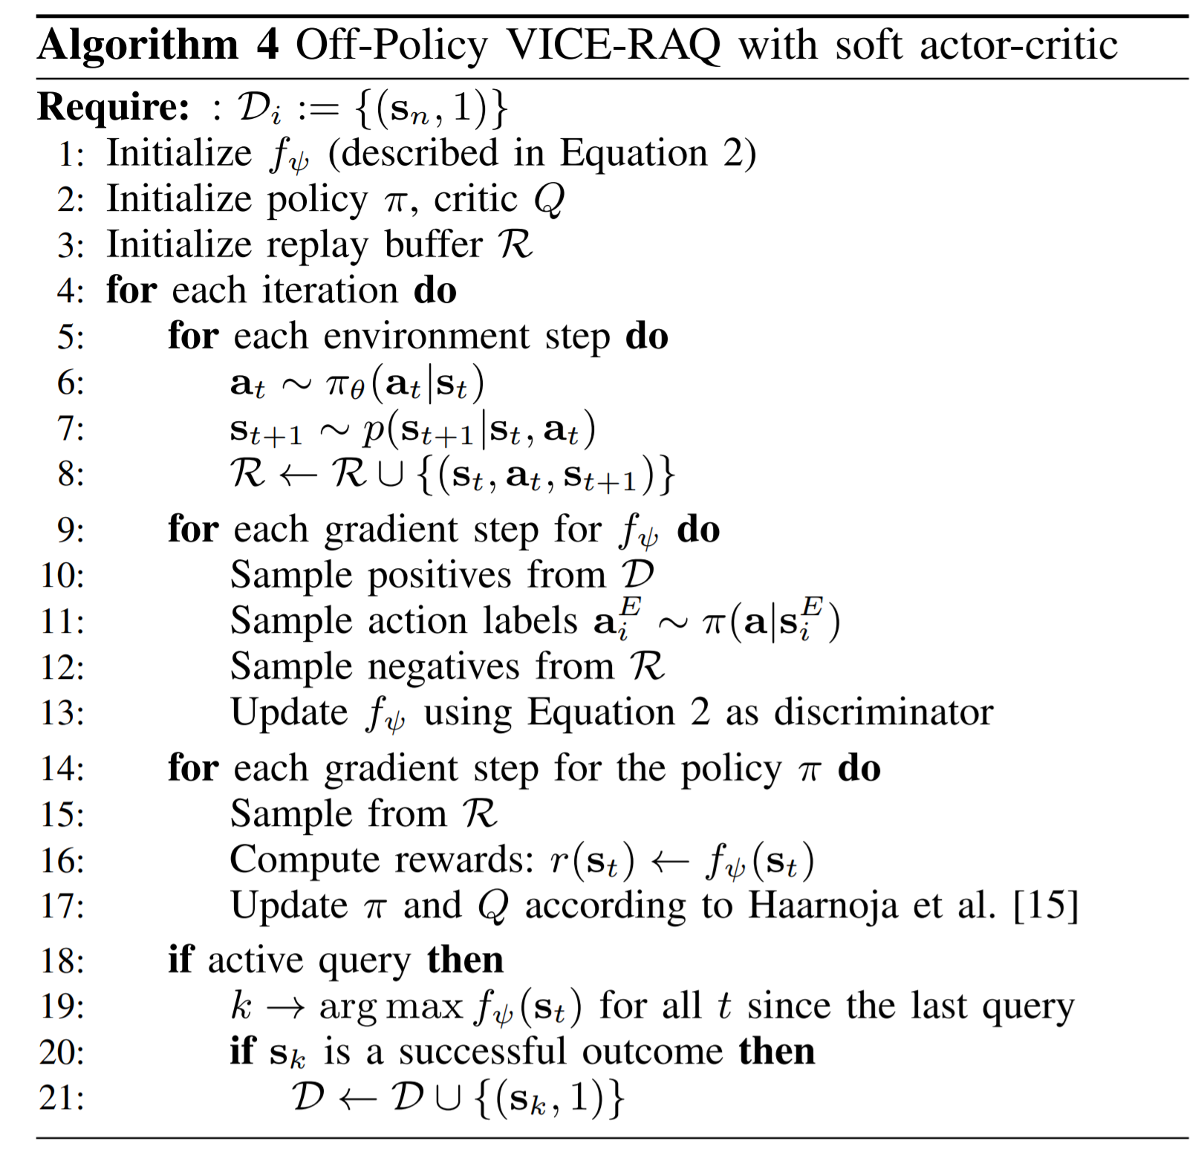
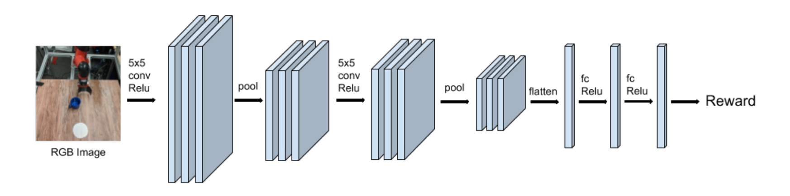
Off-Policy VICE-RAQ
Make it compatible with off-policy deep RL
CNN used for policy, critic, and reward
Notes:
Therefore, we remove the need for the user to specify actions by integrating out the actions for the positive examples in the VICE discriminator update, by using the current policy π(a|s). This amounts to sampling the actions for the positives,

Slide 19
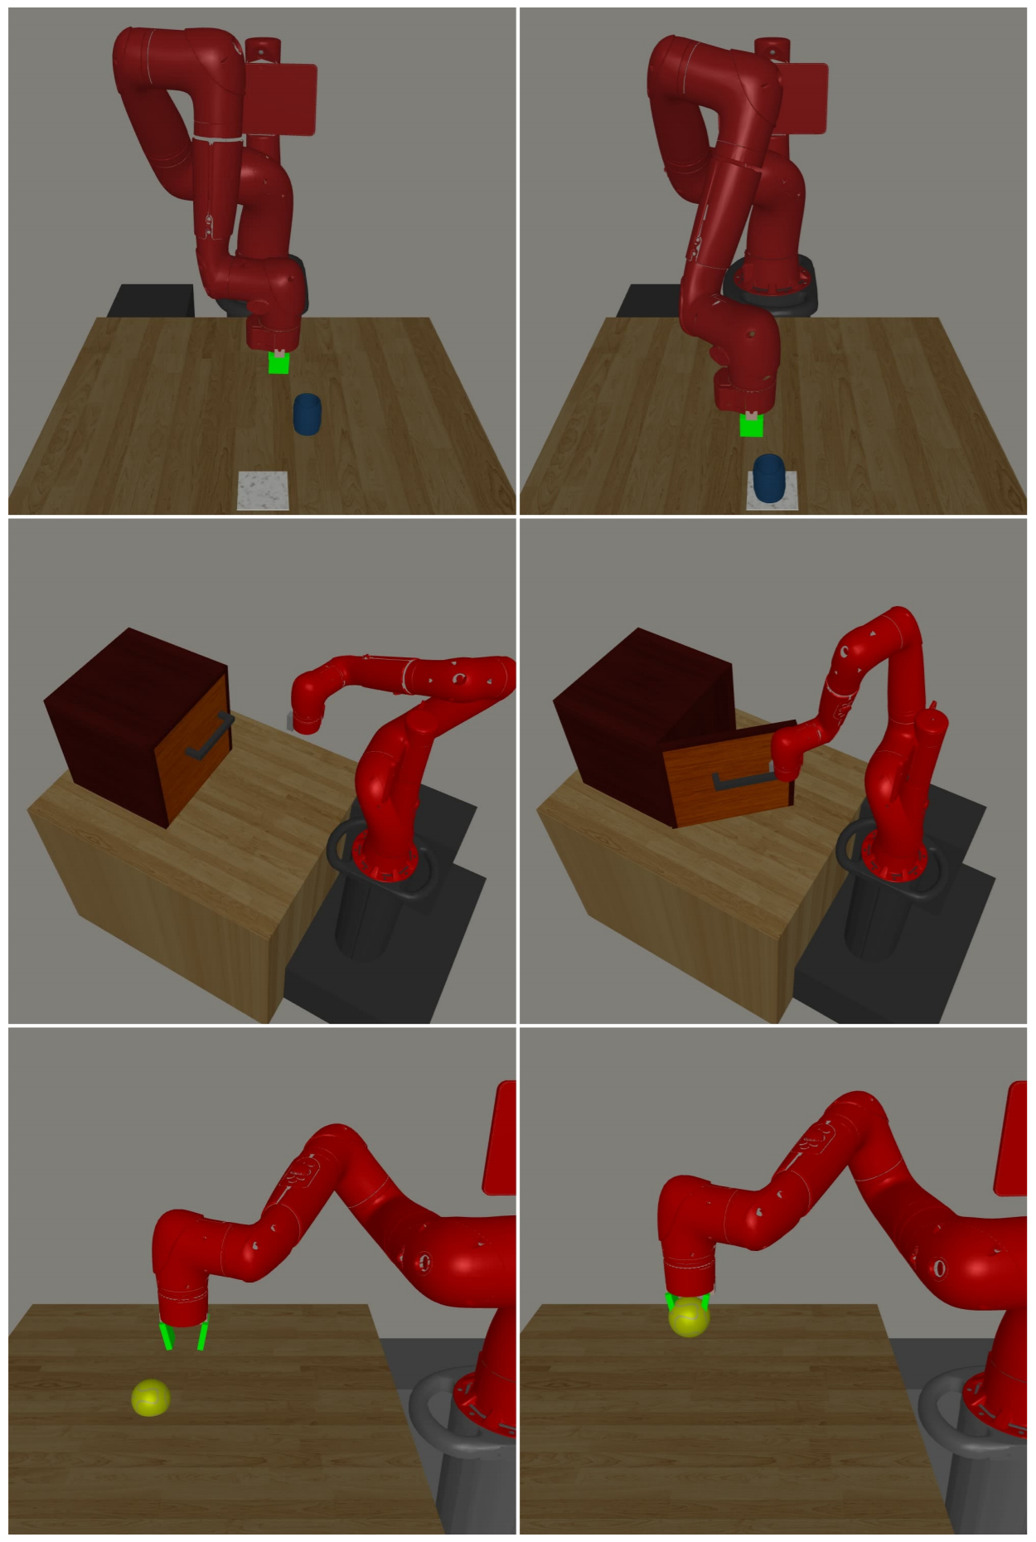
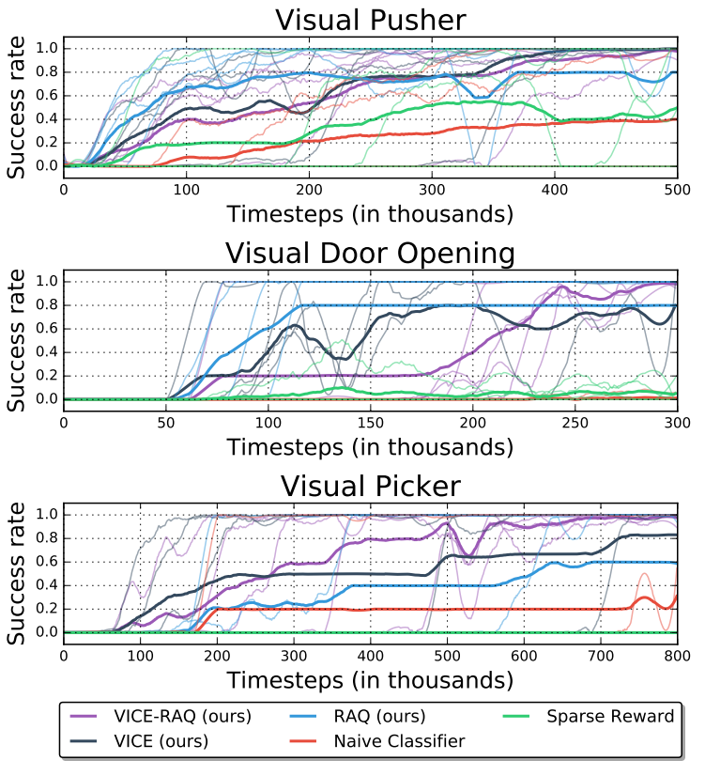
Experiments - Simulation
Start End
10 goal examples
Active query once every 25K / 10K / 1K timesteps

Slide 20
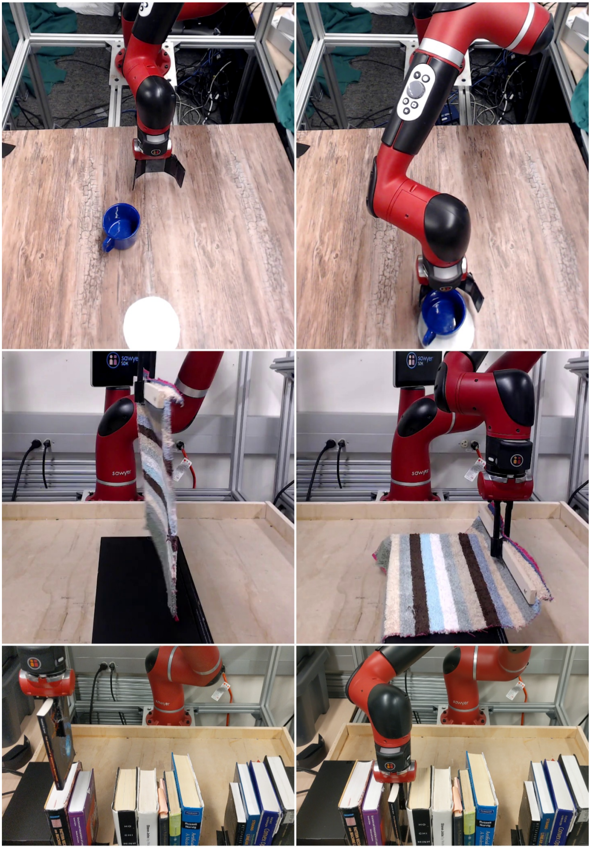
Experiments – Real world
80 goal examples
Active query once every 250 / 500 / 250 timesteps
Total 6.2K(1.5h) / 25K(4h) / 19K(3h) timesteps
25 / 50 / 75 queries
Pushing
Draping
Bookshelf

Slide 21
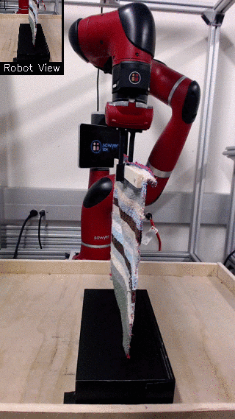
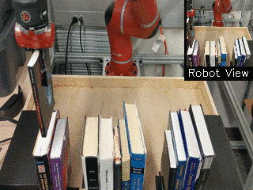
Experiments – Real world

Slide 22
Discussion
Strengths
No hand-programmed reward functions required
Modest number of examples are enough
Limitations
Obtaining query labels from the user may not be favorable
Number of queries required (roughly 50) still not small enough
Does not benefit from any shared structure between tasks
Notes:
metalearning could in principle further reduce the number of queries and examples that is needed

Slide 23
Leveraging Demonstrations for Deep Reinforcement Learning on Robotics Problems with Sparse Rewards

Slide 24
Contribution
An off-policy, replay-memory-based RL that uses demonstrations to learn tasks specified by sparse reward tasks
Demonstrations by humans
Sparse rewards – e.g. +1 if wire is inserted, 0 otherwise
Experiments on a set of robot insertion problems involving rigid and flexible objects.

Slide 25
DDPG
An actor-critic algorithm which concurrently learns a Q-function and a policy
Properties
Off-policy algorithm.
Used only for environments with continuous action spaces.
Like deep Q-learning for continuous action spaces
Knowing the optimal action-value function Q*(s,a), in any given state, the optimal action a*(s) can be found by solving:
a*(s) = argmax_{a}Q*(s,a)
Notes:
It uses off-policy data and the Bellman equation to learn the Q-function, and uses the Q-function to learn the policy
closely connected to Q-learning and is motivated the same way: if you know the optimal action-value function Q*(s,a), then in any given state, the optimal action a*(s) can be found by solving:

Slide 26
DDPG from Demonstrations
Transitions from a human demonstrator are added to the replay buffer.
Prioritized replay is used for sampling transitions across both the demonstration and agent data.
A mix of 1-step L₁(θ^{Q}) and n-step return L_{n}(θ^{Q}) losses are used.
Learning multiple times per environment step.
L2 regularization losses on the weights of the critic L^{C}_{reg}(θ^{Q}) and the actor L^{A}_{reg}(θ^{π}) are used
Notes:
keeps all transitions forever.
Prioritized experience replay [13] modifies the agent to sample more important transitions from its replay buffer more frequently.
Different transitions have different probability of being sampled
use a mix of 1-step and n-step returns when updating the critic function. Incorporating n-step returns helps propagate the Q-values along the trajectories.
If a single learning update per environment step is used, each transition will only be sampled as many times as the size of the minibatch
we require data efficiency and therefore we need to use each transition several times
to stabilize the final learning performance

Slide 27
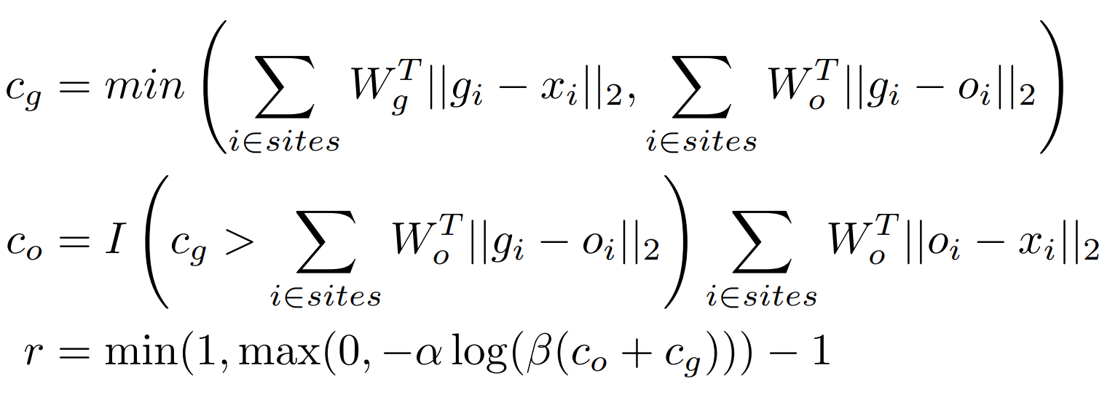
Reward Functions
Sparse reward function:
Shaped reward function:
Two movements – reaching phase c_{o} and inserting phase c_{g}
Notes:
xi is the position of the i th tip site on the plug, gi is the i th goal site on the socket, Wg contains weighting coefficients for the goal site error vector, and is a proximity threshold. If this tolerance was reached, the robot received the reward signal and the episode was immediately terminated.
compute a weighted `2-distance between the plug tip(s) and their respective goal site(s).
oi is the i th opening site, Wg and Wo are weighting coefficients for the goal and opening site errors, respectively, I is the indicator function, and α and β are scaling parameters for log-transforming these distances into rewards ranging from 0 to 1. Note that tuning the weighting of each dimension in Wg and Wo must be done very carefully for the agent to learn the real desired task. In addition, the shaping of both stages must be balanced out in a delicate manner.

Slide 28
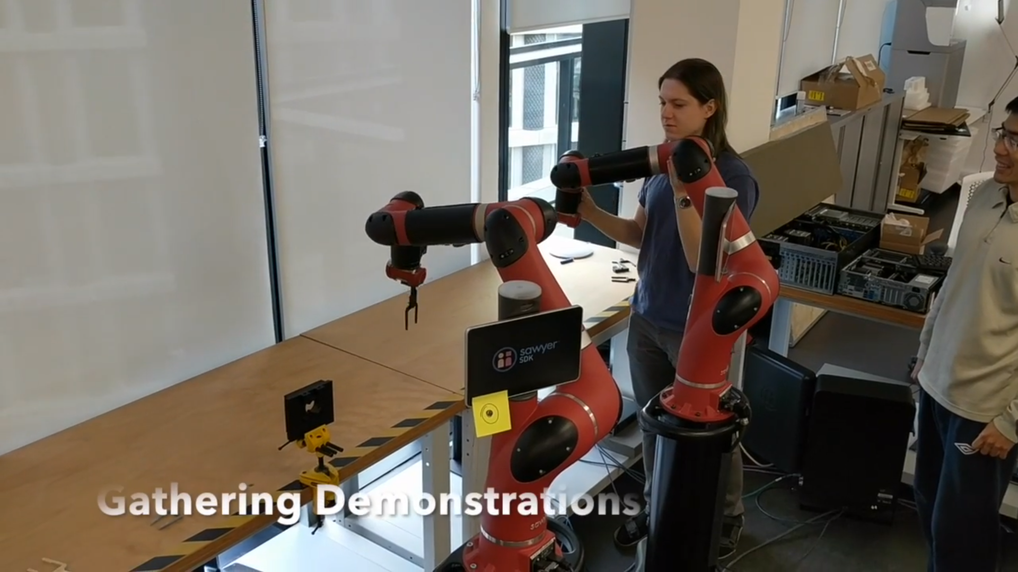
Demonstration
In simulation and real world
Kinesthetically force controlled by human
100 episodes of human demonstrations
Each about 25 steps (~ 5 seconds)
Total 10~15 minutes of interaction per task

Slide 29
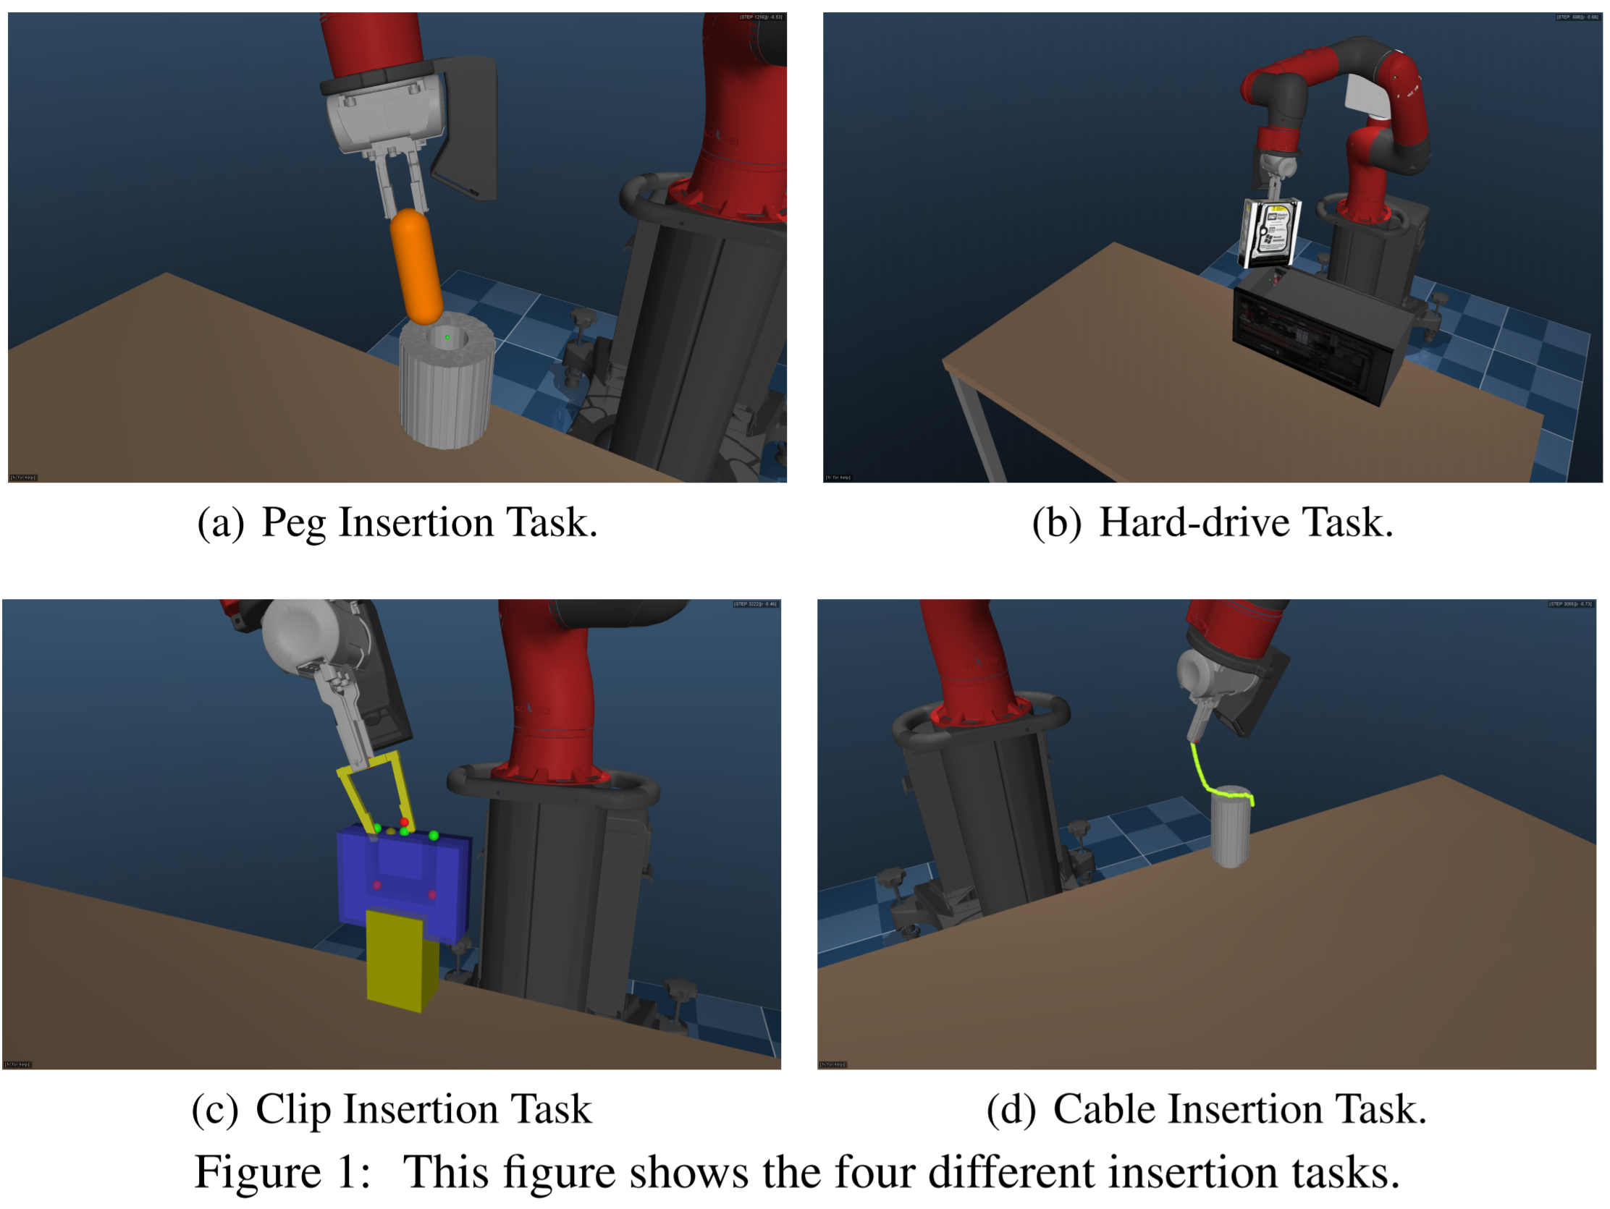
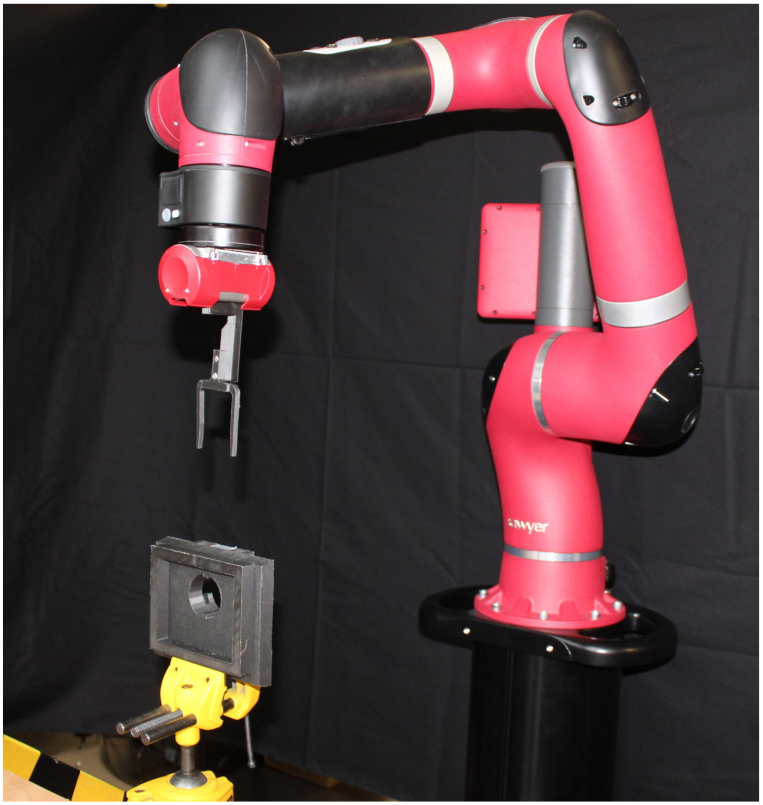
Experiment
Simulation Real world

Slide 30
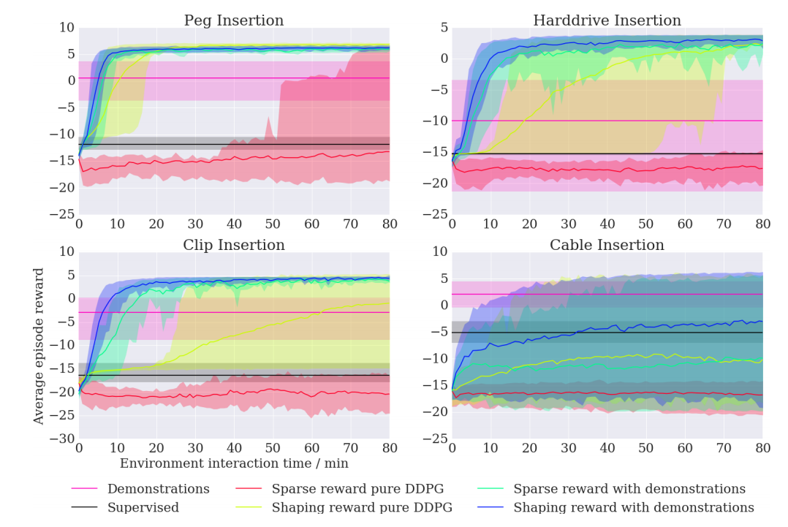
Results
Notes:
We can see that in the case where we have hand-tuned shaping rewards all algorithms can solve the task. The results show that DDPGfD always out-performs DDPG, even when DDPG is given a well-tuned shaping reward. In contrast, DDPGfD learns nearly as well with sparse rewards as with shaping rewards. DDPGfD even out-performs DDPG on the hard drive insertion task, where the demonstrations are relatively poor. In general, DDPGfD not only learns to solve the task, but learns to solve it more efficiently than the demonstrations, usually learning to insert the object in 2-4x fewer steps than the demonstrations. DDPGfD also learns more reliably, as the percentile plots are much wider for DDPG. Doing purely supervised learning of the demonstration policy performs poorly in every task.

Slide 31
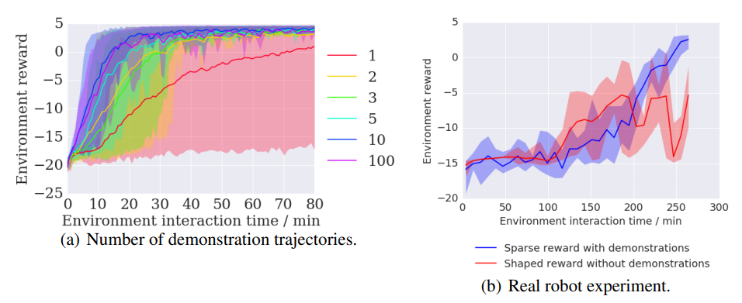
Results
Notes:
DDPGfD is capable of solving this task with only a single demonstration, and we see diminishing returns with 50-100
results of DDPGfD learning the clip insertion task on physical Sawyer robot in Figure 4(b). DDPGfD was able to learn a robust insertion policy on the real robot. DDPGfD with sparse rewards outperforms shaped DDPG, showing that DDPGfD achieves faster learning without the extra engineering.

Slide 32
Discussion
Strengths
No hand-programmed reward functions required
Require only a short time of interaction for training
Limitations
Demonstration can be difficult to provide
Notes:
metalearning could in principle further reduce the number of queries and examples that is needed

